Slide 1

Pulse and digital techniques
ALU Unit
Enrique J. Castellano Martín

Slide 2
<number>
Index
Selected Project
Materials
VHDL Programming
Video

Slide 3
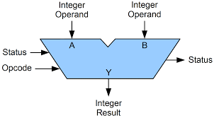
<number>
Selected Project
ALU unit with its own set of arithmetic/logic/binary operations.
An ALU (Arithmetic Logic Unit) is combinational digital electronic circuit that performs arithmetic and bitwise operations on integer binary numbers.

Slide 4
<number>
Selected Project
I inspired in the device 74181:
- First complete ALU on a single chip
- It’s a 4-bit wide ALU
- It can perform all the traditional add / subtract / decrement operations with or without carry, as well as AND / NAND, OR / NOR, XOR, and shift.

Slide 5
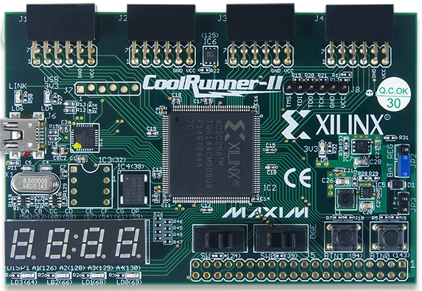
<number>
Materials

Slide 6
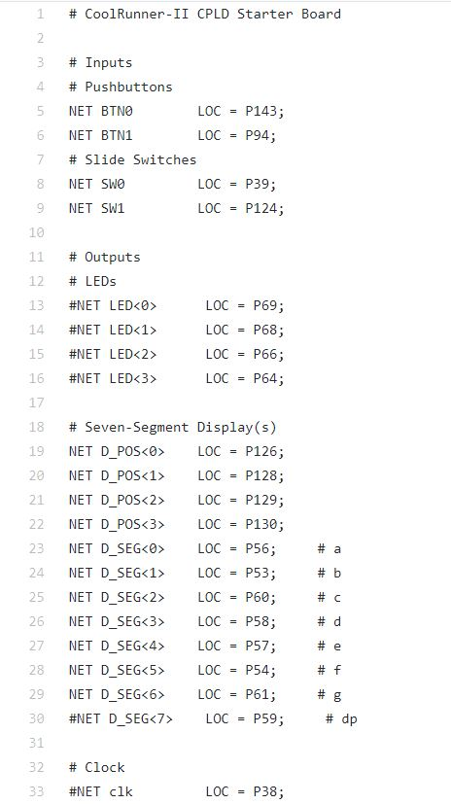
<number>
VHDL Programming
Implementation Constraints File

Slide 7
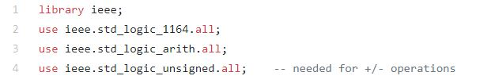
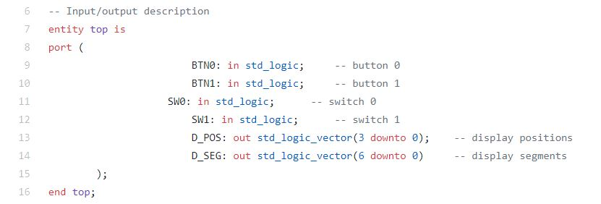
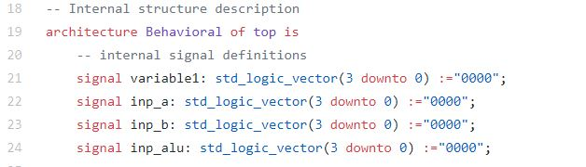
<number>
VHDL Programming
VHDL module

Slide 8
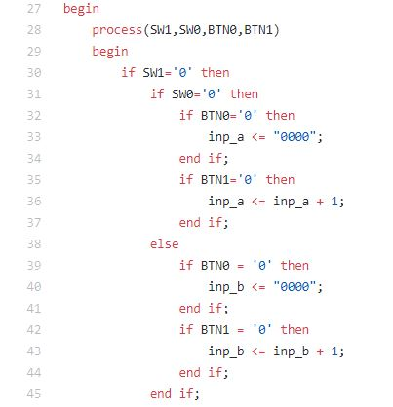
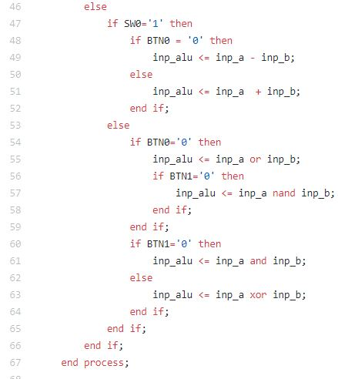
<number>
VHDL Programming
VHDL module

Slide 9
<number>
VHDL Programming
VHDL module

Slide 10
<number>
Thank you for your attention

